Slide 1


Capstone Project – Applied Data Science | Coursera
Battle of Neighborhoods

Slide 2
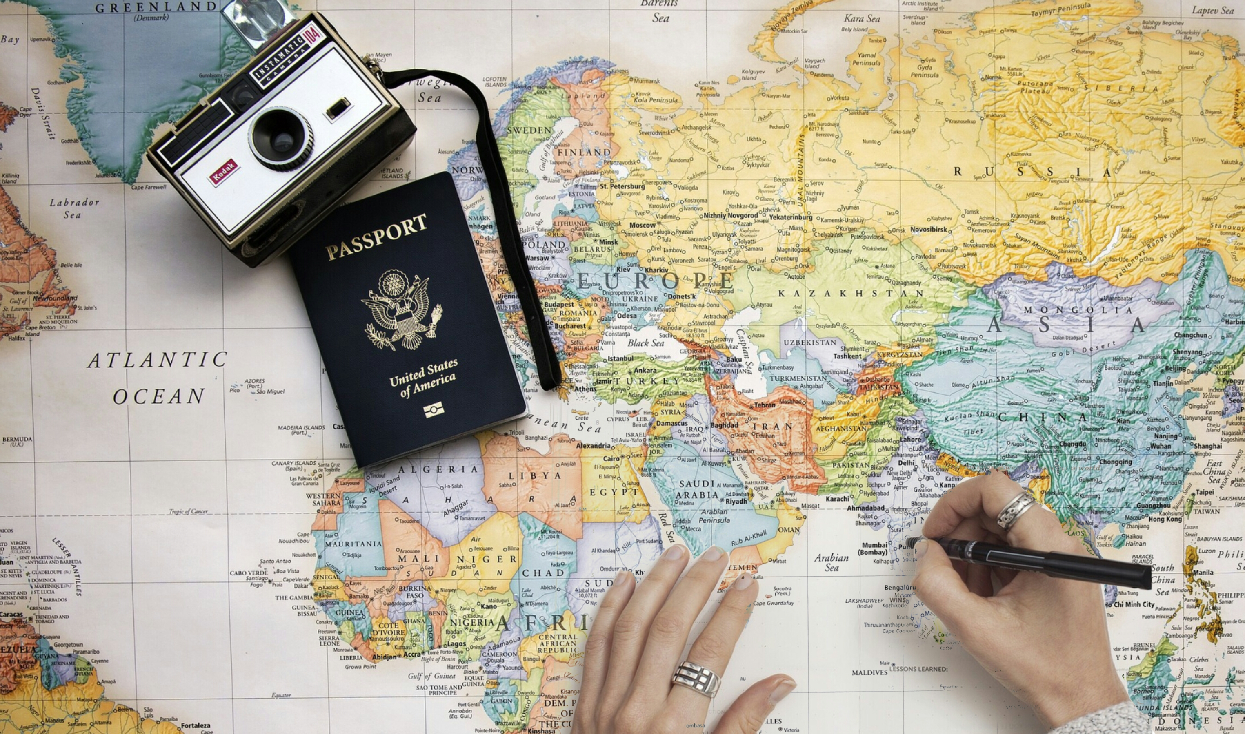





Preprocessing
Clustering
Results
Introduction
Analysis

Slide 3

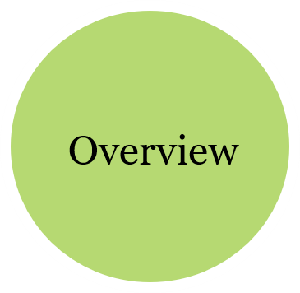
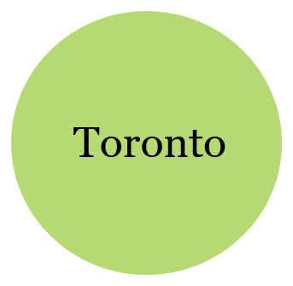
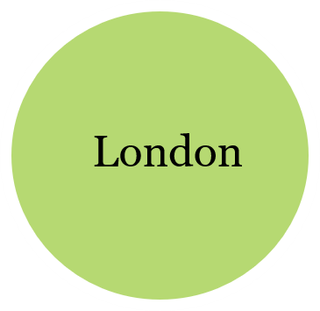
Introduction

Slide 4





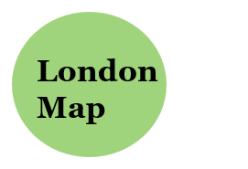
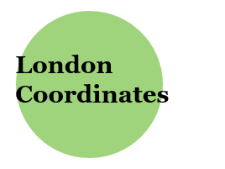
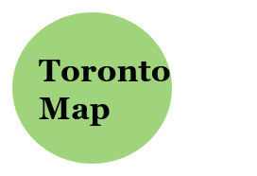
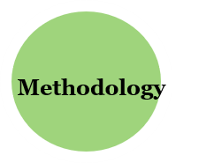
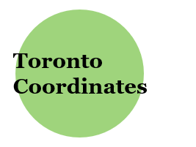
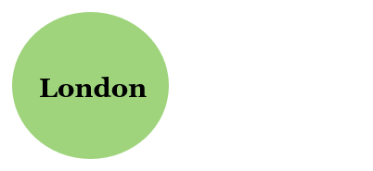
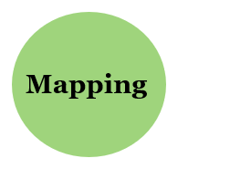
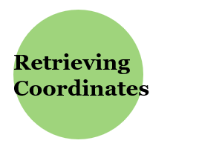
Initial Dataset
Preprocessing
Visualize
Coordinates

Slide 5




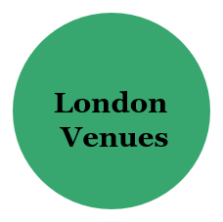
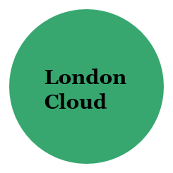
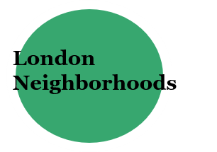
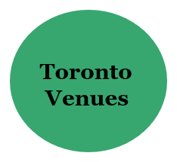

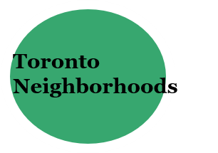
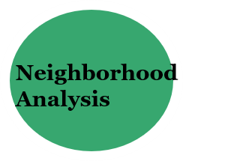
Analysis
Foot Traffic
Word Cloud

Slide 6

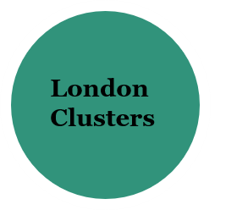
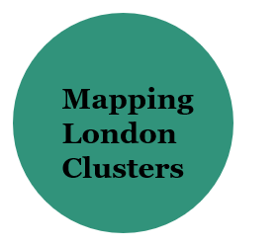
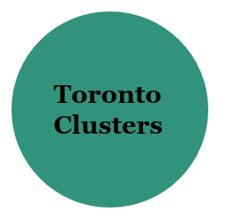
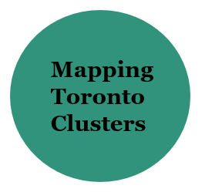
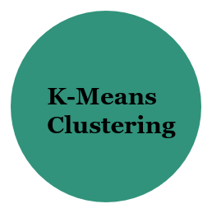
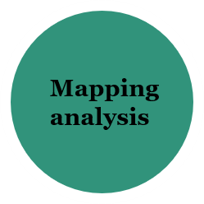
Cluster

Slide 7



Results

Slide 8
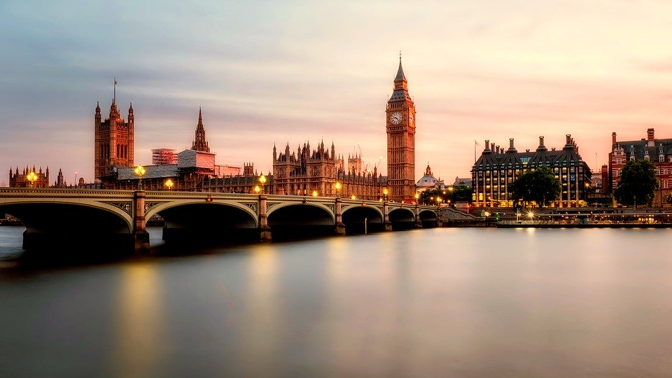
London
London is the capital and largest city of England and the United Kingdom.
- Standing on the River Thames in the south-east of England, London has a diverse range of people and cultures, and more than 300 languages are spoken in the region.
- Its estimated mid-2018 municipal population (corresponding to Greater London) was 8,908,081, the most populous of any city in the European Union and accounting for 13.4% of the UK population

Slide 9
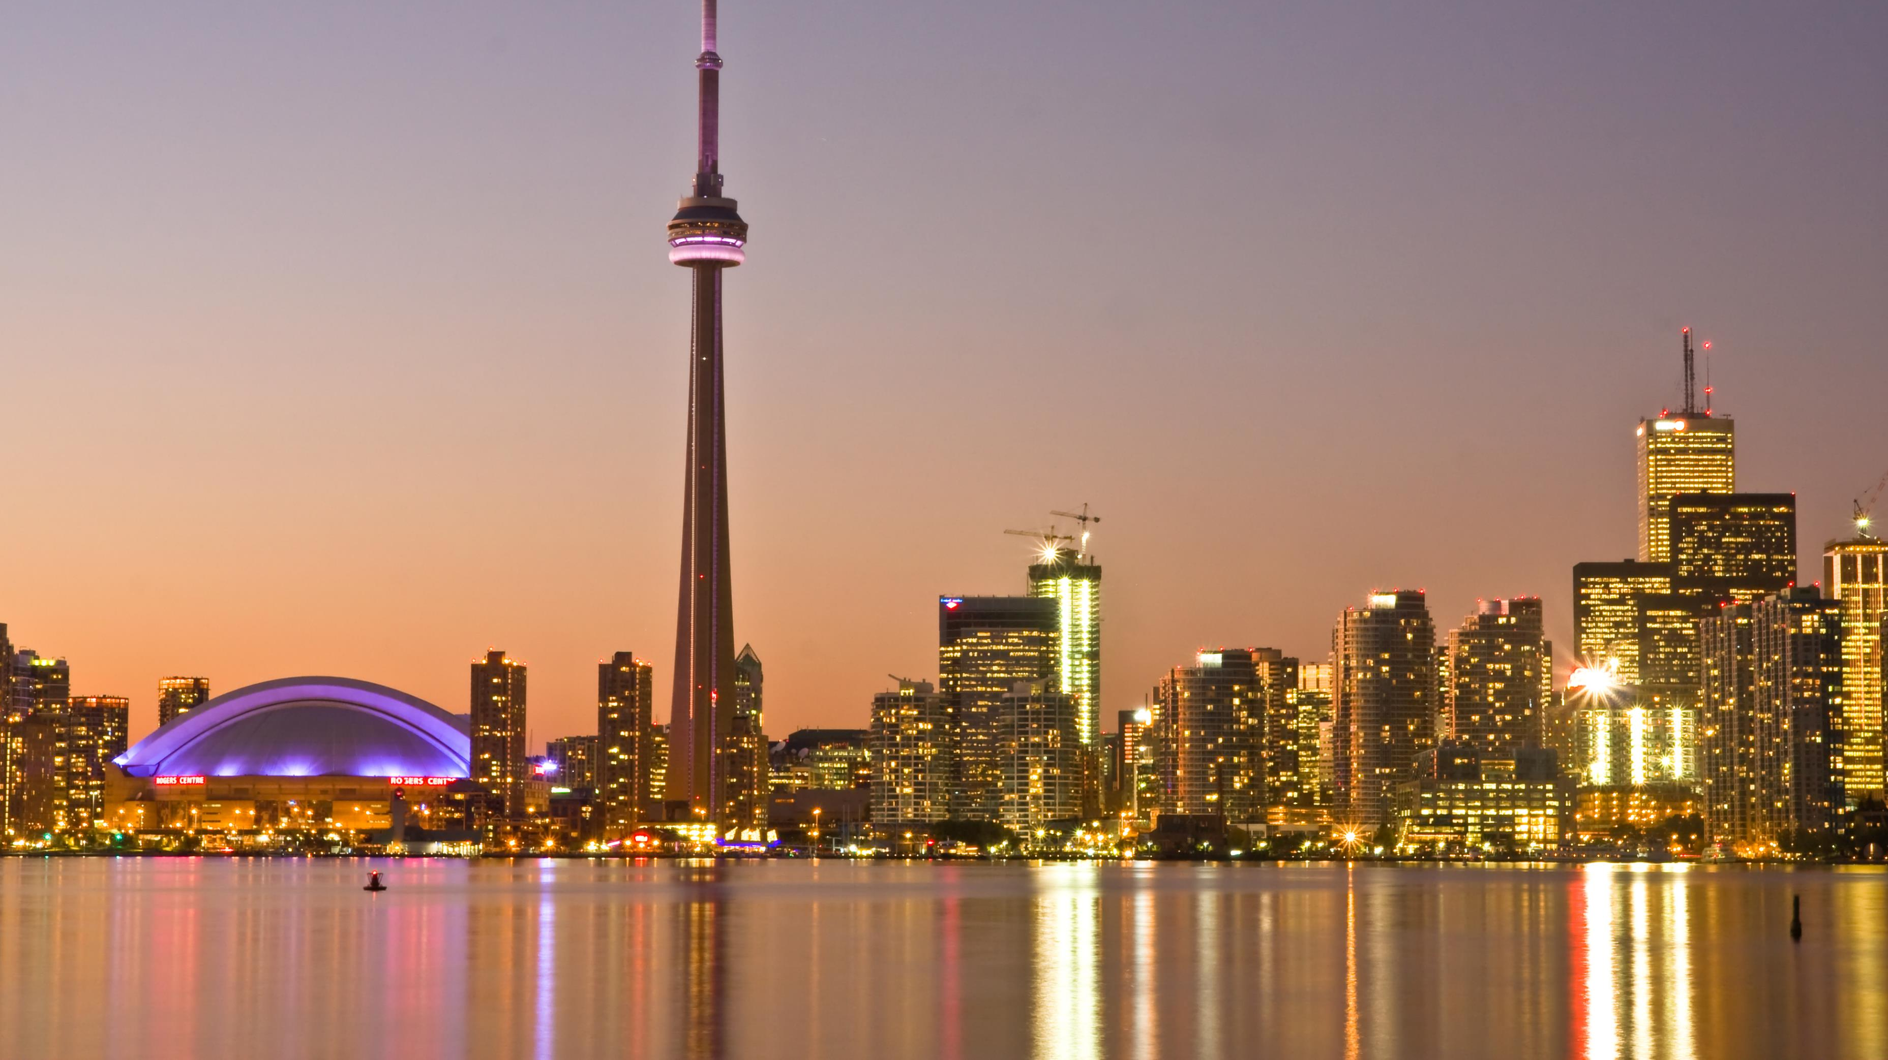
Toronto
Toronto is the provincial capital of Ontario and the most populous city in Canada,
- With a population of 2,731,571 as of 2016. More than 50 percent of residents belong to a visible minority population group, and over 200 distinct ethnic origins are represented among its inhabitants.
- While the majority of Torontonians speak English as their primary language, over 160 languages are spoken in the city.

Slide 10

Overview
Both the cities are financial capitals of respective countries and are diverse in cultures, as well as these cities have many visitors every year. So, the aim of the project is to analyze the similar and dissimilar interests of the people living in both the cities and determine the localities that are popular for some specific venue categories. Considering the interests of peoples in both cities, we can plot these interests on the map.
Data Description
To consider interests among cities, we can list the data as below:
I found Neighborhoods with their Borough and postal codes on Wikipedia, so I scraped the neighborhood data of both the cities from Wikipedia tables[1][2] using the beautiful soup library of python.
Used geocoder ArcGIS to get latitude and longitude for each neighborhood.
I used Foursquare API to get the most common venues of given Borough of Toronto and London.

Slide 11
Methodology
Initially Dataset contains three primary attributes
-Postal-code
-Borough
-Neighborhoods

Slide 12
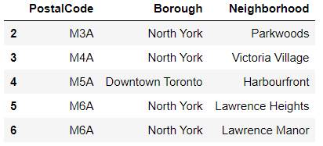

Slide 13
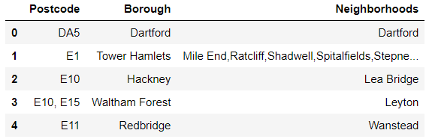

Slide 14
Mapping
I used the python folium library to visualize geographic details of both cities and their boroughs.
Created a map of cities with Neighborhoods superimposed on top.
I used latitude and longitude values to get the visual as below:

Slide 15
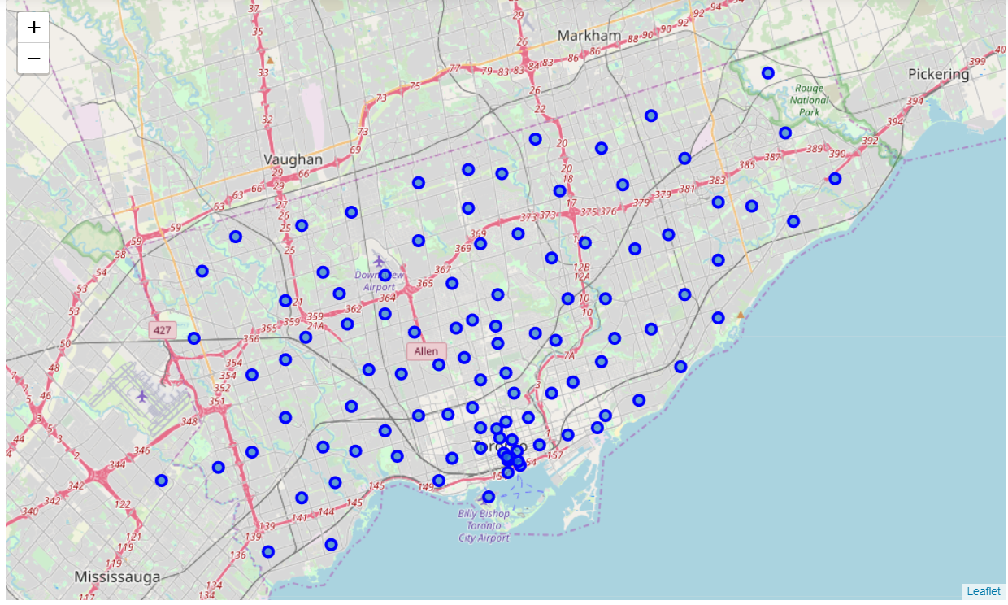

Slide 16
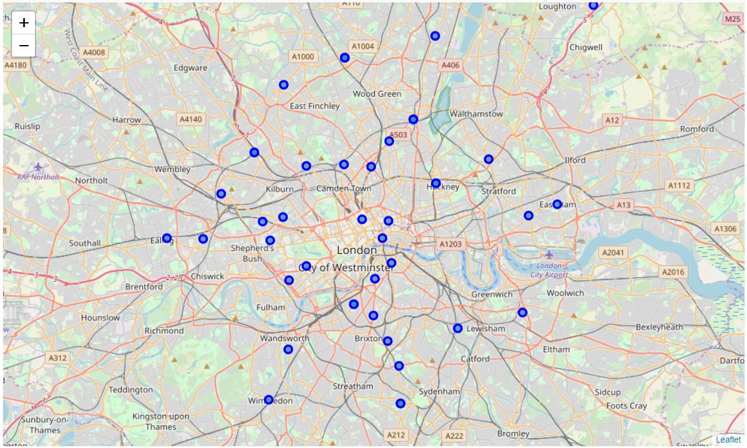

Slide 17
Coordinates
I utilized the Foursquare API to explore the Neighborhoods and segment them. I designed the limit as 100 venues and the radius 500 meters for each borough from their given latitude and longitude information. Here is ahead of the list Venues name, category, latitude and longitude information from Foursquare API.
In summary of this data 1675 venues for Toronto and 1467 venues for London were returned by Foursquare. Here is a merged table of boroughs and venues.

Slide 18
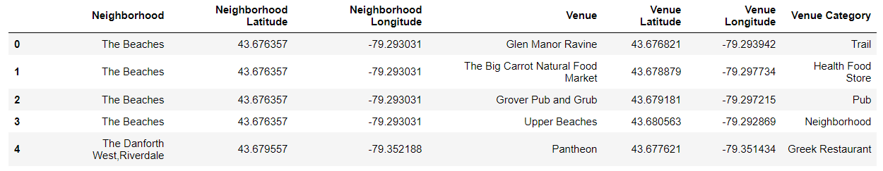

Slide 19
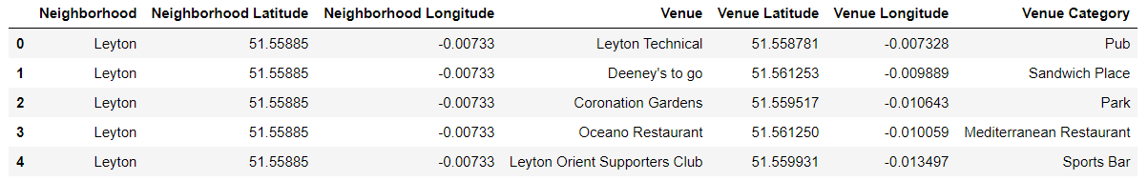

Slide 20
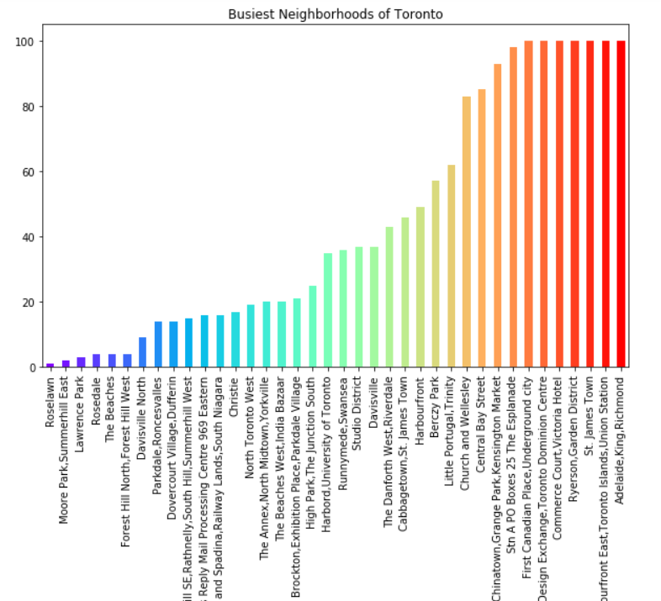
Busiest Neighborhoods in Toronto

Slide 21
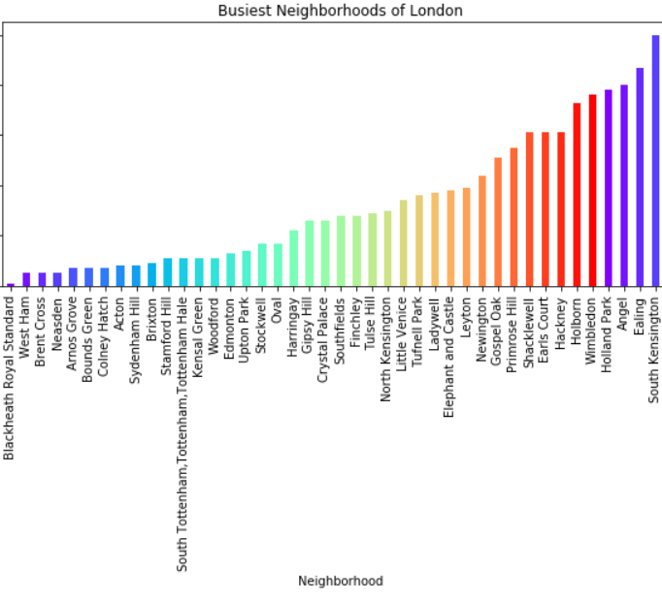
Busiest Neighborhoods in London

Slide 22

Explanation
We can see that Temple and South Kensington in London and Adelaide, Toronto Dominion Centre, First Canadian Place, Harbour front East, Garden District, and St. James Town in Toronto reached the 100 limits of venues. On the other hand; Blackheath, West ham, Brent Cross, Neasden in London and Roselawn, Moore Park, Lawrence Park, Rosedale in Toronto- boroughs are below 10 venues in our given coordinates with Latitude and Longitude, in below graph.
The result doesn’t mean that inquiry run all the possible results in boroughs. Actually, it depends on given Latitude and Longitude information and here is we just run single Latitude and Longitude pair for each neighborhood. We can increase the possibilities with Neighborhood information with more Latitude and Longitude information.

Slide 23

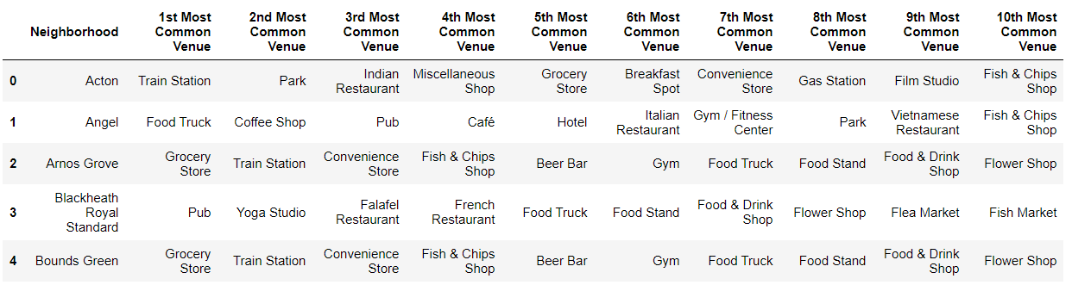
Top 10 Venues W.R.T. London Neighborhoods

Slide 24
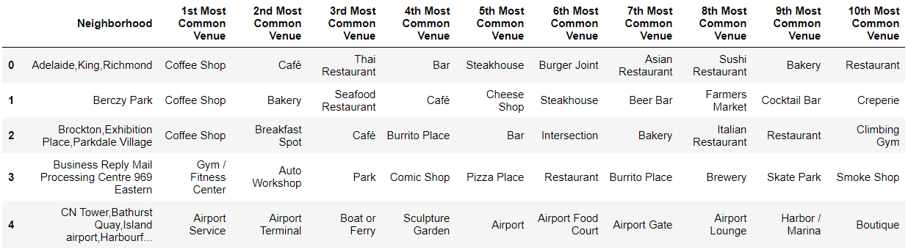
Top 10 Venues w.r.t. Toronto Neighborhoods

Slide 25
Visualizing Word Cloud for Popular categories
London -
From the generated word cloud, we can see that people in London have a pretty outgoing life as Pubs, Café, Coffee Shops, Restaurants are very popular.
Toronto -
Looking at Toronto people’s interests indicates that Restaurants, Coffee shops, Stores are more popular.
Analysis –
Analyzing both the images we can say that most people have similar interests in both the cities. Mainly Italian Restaurants are popular in both cities. Also, people drink a lot of coffee and eat out are restaurants in both cities.

Slide 26
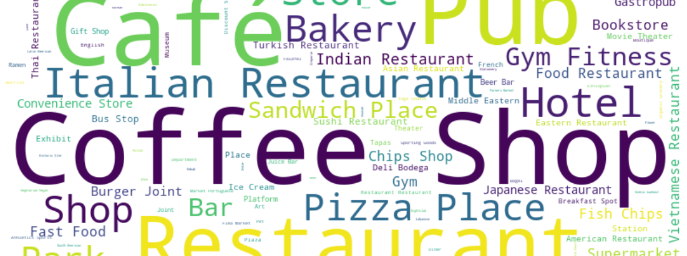
Word Cloud for the most popular categories of venues in London

Slide 27
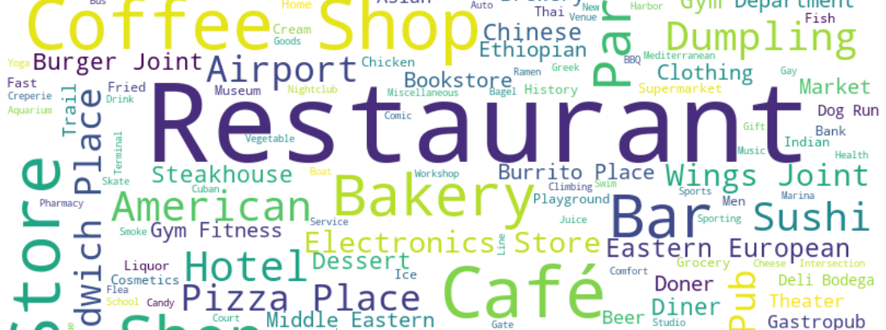
Word Cloud for the most popular categories of venues in Toronto

Slide 28
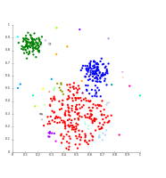
K-Means Clustering
Further analysis, We have some common venue categories in boroughs. For this reason, I used unsupervised learning K-means algorithm to cluster the boroughs. K-Means algorithm is one of the most common cluster methods of unsupervised learning.
Optimal k is found out using the elbow method which gives k as 5 for both the cities.
Here is my merged table with cluster labels for each Neighborhood.

Slide 29
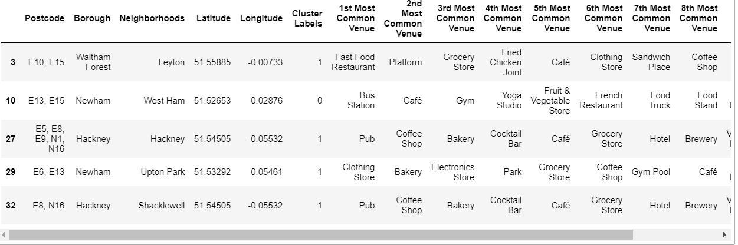
Getting clusters of London Neighborhoods

Slide 30
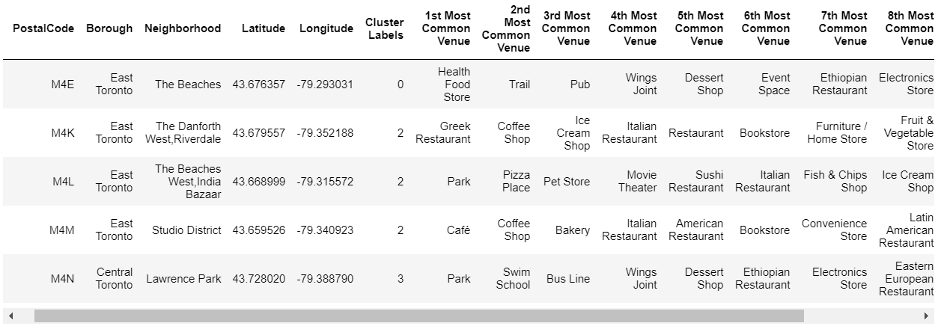
Getting Clusters of Toronto Neighborhoods

Slide 31
Visualizing clusters as Bar Charts
When we examine the above graph for London we can label each cluster as follows:
Cluster 0: “ Public Transit-Bus”
Cluster 1: “Best Night Life - Pubs”
Cluster 2: “Nightlife - Pubs & Dining”
Cluster 3: “Grocery House”
Cluster 4: “Super Markets”
When we examine the above graph for Toronto we can label each cluster as follows:
Cluster 0: “ Health & Food Stores”
Cluster 1: “Parks”
Cluster 2: “Coffee Shops”
Cluster 3: “Sandwich place & Parks”
Cluster 4: “Gardens”

Slide 32
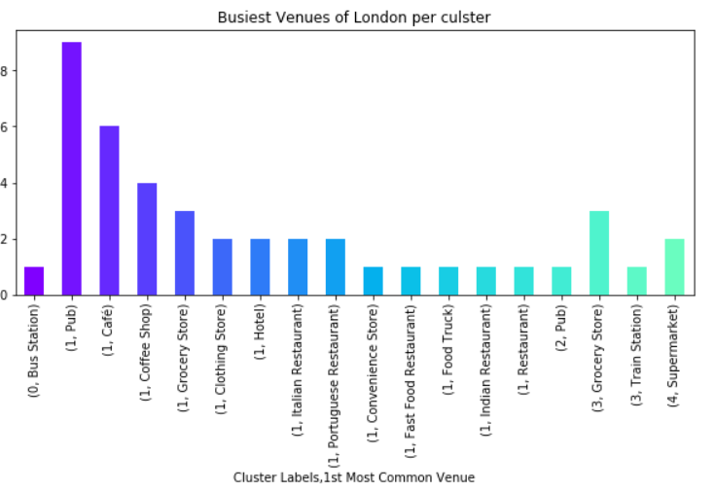

Slide 33
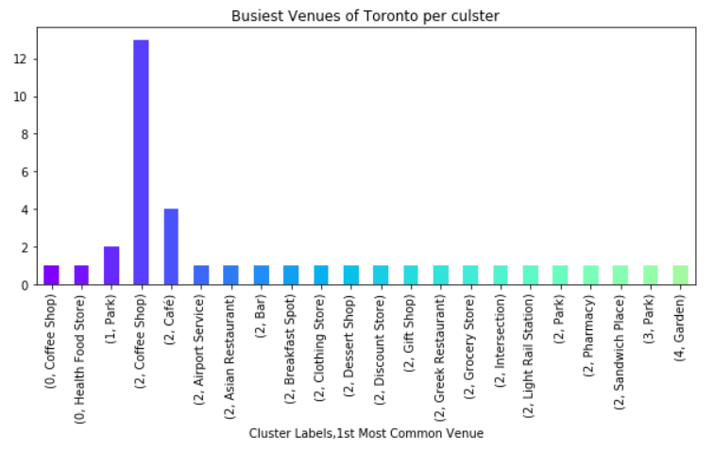

Slide 34
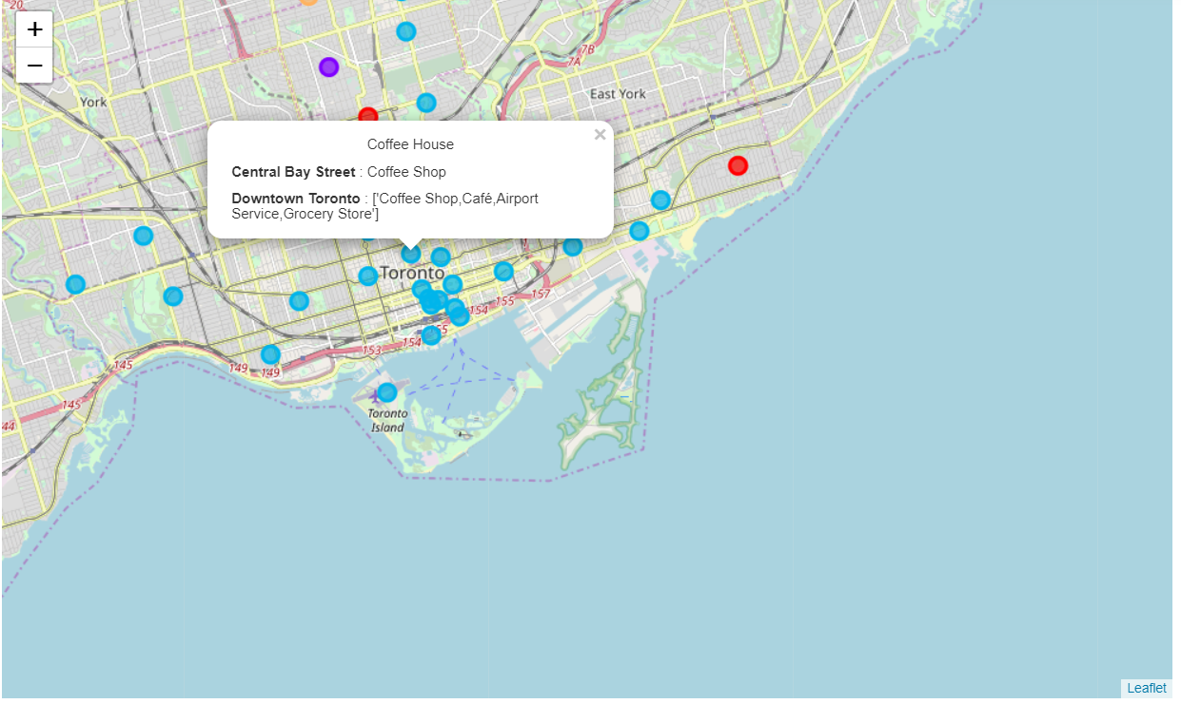

Slide 35
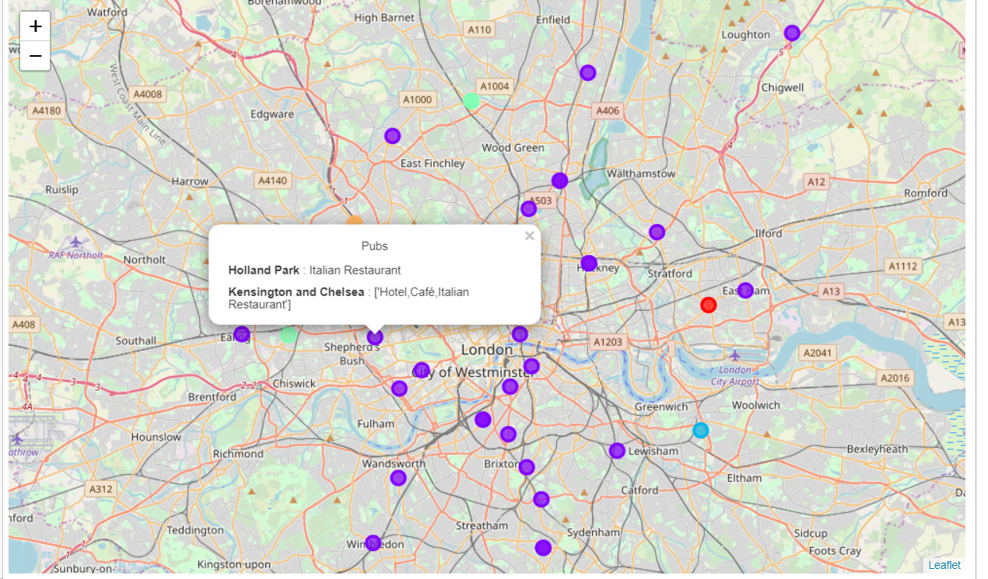

Slide 36
Analysis on the Mapped Clusters
The map shows the different colors for different clusters. One of the clusters is comparatively big than others which is more of Downtown London. Similarly, for Toronto, the cluster that has more focus towards downtown is significantly bigger than others, because all the venues are near downtown and few towards the outskirts of the city.
One of the aims of the project was to make a map that would indicate the top venue in that neighborhood. So, I have made a popup that carries some meaningful information. The title is the name of the Cluster that is determined by the bar graph which will be discussed in the above section. After the title, the 1st Highlighted name is the name of Neighborhood with its most popular venue category. 2nd Highlighted Title is the name of Borough in which the neighborhood relies upon its most popular(“1st most common venue”) column from the data frame.

Slide 37

Discussion
As I have discussed both cities are very diverse and have a dense population. In the whole analysis, I have bought to you what are similarities and dissimilarities between these two cities we will discuss in detail below. we have visualized neighborhoods on the map where one can easily know which is the go-to venue in each neighborhood and some venues that are popular nearby in that borough.
Also, we can say that some of the neighborhoods that we analyzed using the bar graphs are busiest and crowded with multiple popular venues. I could have analyzed this venue further if I had access to foursquare premium calls, we could have analyzed the age breakdown of public with venues, the number of checking’s in venues, which hours of the day venues are crowded, etc.
I have used k-means clustering for the analysis of clusters and even it is basic more rigorous classifiers can be used in this scenario and could have got more insights. Tough I have used k=5 for clustering one of the clusters is very big in both the city i.e. downtown area in both the cites
I have ended by visualizing the clusters on the Maps of both cities with some useful information on popups. This data can be further used to analyze these venues accurately.

Slide 38

Conclusion
Firstly, we have determined the busiest Neighborhoods in both the cities, also some venues popular in these neighborhoods.
Similarities between the interests of peoples in Toronto and London:
1. Many people eat out in restaurants and mainly Italian Restaurants are popular in both cities.
2. People like to grab a coffee at cafes and coffee shops.
3. Both cities have Parks and Gardens and are popular in some neighborhoods that are away from Downtowns of cities.
4. Little outskirts of the city are well equipped with public transits like busses.
Dissimilarities between interests of peoples in Toronto and London:
1. Most People go to Gyms in London while it's not the case with Toronto.
2. Pubs are very popular in London while Bars are there in Toronto but not as many people visit those.
In conclusion, I can say that the interests of people are not divided by diversity or different continents. If one is living in financial capitals like Toronto or London, he/she will tend to go out to dine in restaurants, visit Pubs/Bars at weekends, grab coffee frequently and to take some time out from busy life to go to parks/gardens and gyms.

Slide 39

Thank You !

